Slide 1
Model and High Power Rocketry
Mike Williams, 802

Slide 2
Me
Mike Williams, UKRA founder member, former chairman now running the MAP program.
G6BMZ
SMAS member 802

Slide 3
Bad Language Warning
Some terms are horribly interchangeable
Its all metric except when its Imperial except when it isn’t
Mass is not weight and weight is not mass, kinda
Some videos need to be loud, and sort of shouty
Notes:
Gunpowder! F Fg FA FC and on and on but usually FFFFg

Slide 4
The top questions
Is it Legal?
How high do they go?
What is the fuel?
… and how do they work?

Slide 5
Is it legal?
Short answer
Bit longer answer
Yes
Law treats model rockets in a very similar way to garden fireworks
Making your own pyrotechnic motors is illegal
Stay within the rules
HSE covers most motor issues
Air navigation orders apply
Very large flights are rarely practical
Things falling from space can be a problem

Slide 6
How high do they go?
Short answer
Bit longer answer
Give me enough space and a big enough bang and 50km is possible.
Models, 2000 feet
High Power, 10,000 feet
Easy to acquire motors are good for about 3000 feet
Largest motors can get much higher, say 20km.
Flight calculations and simulation
Flight electronics

Slide 7
What is the fuel?
Model rockets
High power (APCP)
Black powder
Clay and cardboard surround
Typical legal requirements are like a firework
Fixed ejection delay
HTPB binder
Perchlorates
Metal filings
Hard plastics and aluminum surround
Limited use of cardboard
[often] Variable delay
Notes:
APCP stands for Ammonium Perchlorate composite propellant.
HTPB Hydroxyl-terminated polybutadiene

Slide 8
but wait, there's more...
HYPRID MOTORS
TYPICALLY
Two or more substances in different states
Very safe
Simple legal requirements
Cheap for high power
Can be very time consuming
NOx oxidiser
ABS plastic fuel
GOx starter
Complex GSE

Slide 9
Finally...
Human
Stomp Rocket
Aquajet
https://www.amazon.co.uk/s?k=stomp+rocket&crid=1STZV3BYDI5L7&sprefix=stomp+rock%2Caps%2C77&ref=nb_sb_ss_ts-doa-p_1_10
Notes:
Picture replaced by link

Slide 10
Midpoint Questions
.

Slide 11
How do they work? Construction
Model rockets
High power
Mainly cardboard
ABS plastic
Balsa
Elastic or rubber bands
Any odd craft stuff
Polythene
Phenolic tubing or purpose designed plastics
Fiberglass
plywood
Kevlar
Ripstop nylon

Slide 12
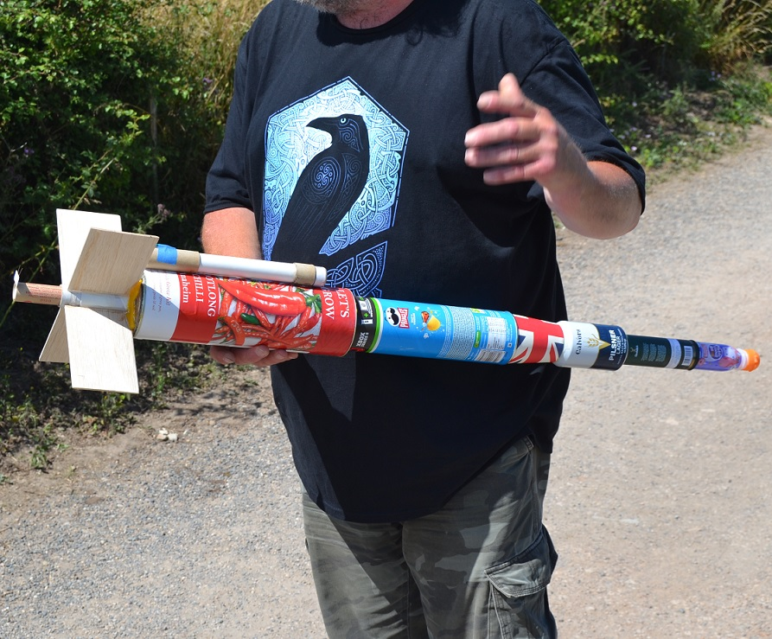
How do they work? Anything you can find
Balsa
Most things tubular
Can get heavy
Pringles a favourite
Recovery

Slide 13
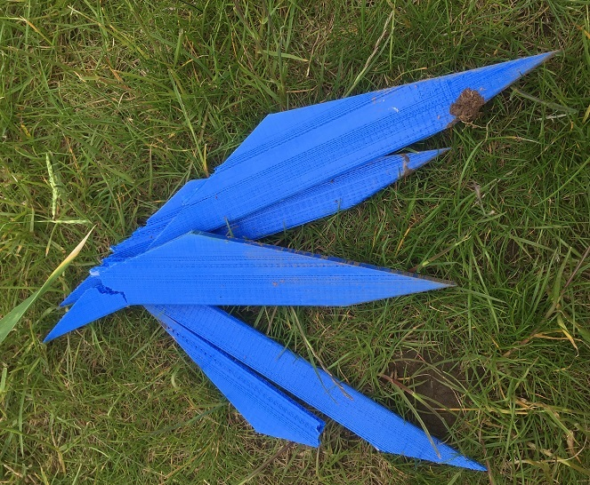
How do they work? A horrible truth, 3D printing
3D printed pla and pla+
Can sort of work
Usually rushed
Similar loads to balsawood but much heavier
Z Axis weakness
Goes soft in the sun

Slide 14
Model Rocket Flight
Notes:
Image from hobby lark

Slide 15
How do they work? Basic Operation
30 seconds of terror
Mechanical support, GSE
Electrical ignition
Lift
Sustain/Delay
Eject/deploy recovery
Hits ground, long walk
https://img.favpng.com/21/1/8/estes-industries-model-rocket-launch-pad-rocket-launch-png-favpng-kqaucSK1igBFu1UWc03UbwBcu.jpg

Slide 16
Image removed:
Image from openRoc Simulation Software.
https://openrocket.info/
Notes:
Basic Rocket from Open Rocket SIM software, we can possibly demo what’s going on in the software later.
SOP vs SOG

Slide 17
How do they work? Ignition and launch

Slide 18
How do they work? Trying to go high
Simple
Not so simple
Go straight
Three fins good, four fins better
No mass you don’t need
Keep the diameter down
Make sure it’s stable
The weather!
Motor selection
Spin stabilisation
Staging, serial and/or parallel
Sustainer darts
Stability margins
Notes:
After a while more bang doesn’t add altitude, burn time does. Ensuring vertical flight is the best way to improve altitude. A sustainer dart is an unpowered stage, usually designed to only fly at high speed at high altitude. May add considerably to the “book” altitude.

Slide 19
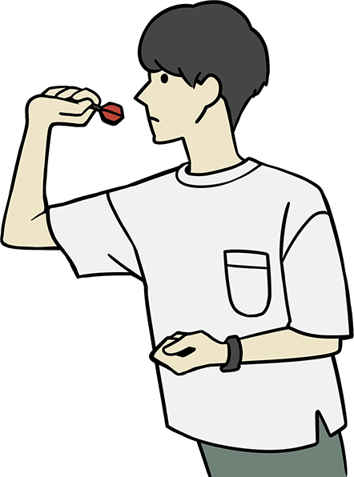
How do they work? Stability margin
Heavy at the pointy end draggy at the other end
Centre of pressure
Centre of gravity
Notes:
COP, for our purposes: the average location of all the dynamic forces acting on the rocket
COG, for our purposes: the average location of all mass components acting on the rocket
Stability is measured on calibres, that is the distance between COP and COG, looking for between 2 and 2.5.

Slide 20
Engine Selection – Single Use Banging and pushing
Notes:
On the left hand side a D12-0 20nS each with an ejection charge instantly after thrust.
On the right Aerotech F26-6FJ. Average thrust 26N, 65N total thrust with a six second delay from ignition.

Slide 21
Engine Selection – Reload Banging and pushing
Notes:
Aerotech on the left and Cesaroni on the right. Dealer only parts.

Slide 22
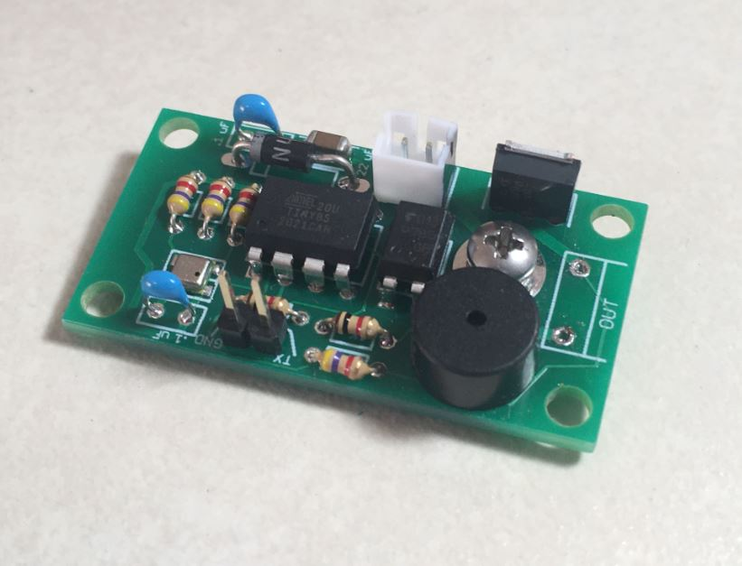
How do they work? Recovery
Simple
Not so simple
At ignition a chemical delay grain starts to burn
During flight delay grain burns for a predictable number of seconds
Once burnt through a black powder charge ignites forces out a parachute*
Electronic devices, Mike talks….
Notes:
Eggtimer rockets
http://eggtimerrocketry.com/wp-content/uploads/2021/10/Quantum-A18-2.jpg

Slide 23
How do they work? Slowing down and stopping
Simple
Not so simple
Break the airframe
Parachute, streamer, ribbon
Unstable when falling, tumble
Helicopter blades
Multiple parachutes
Variations of above
Mixed, such as tumble booster stage

Slide 24
Summary Questions
.

Slide 25
Thank You
Michael Williams
ukra.org.uk
https://ukra-map.org.uk/EE.html

Slide 26
Bonus Material
Hybrid – Not quite right
Model – Next slide not all wood is Goodwood

Slide 27
Balsa
Notes:
So what’s wrong here?

